Slide 1


CS 235: User Interface Design April 9 Class Meeting
Department of Computer Science San Jose State University Spring 2015 Instructor: Ron Mak
www.cs.sjsu.edu/~mak

Slide 2
Microinteractions
The functional, interactive details of a product.
Microinteractions can make the difference between a product that you love to use and one that you merely tolerate.
Good UI designers pay attention to the details as well as to the big picture.
During a design project, try to identify any possible microinteractions.

Slide 3
Microinteractions, cont’d
An exercise in restraint.
Do as much as possible with as little as possible.
Reduce more complex products to simpler products each built around one microinteraction.
“Minimum Viable Product” (MVP)
Most complex digital products consist of dozens or hundreds of microinteractions.
Each microinteraction is an opportunity to delight users and exceed their expectations.

Slide 4
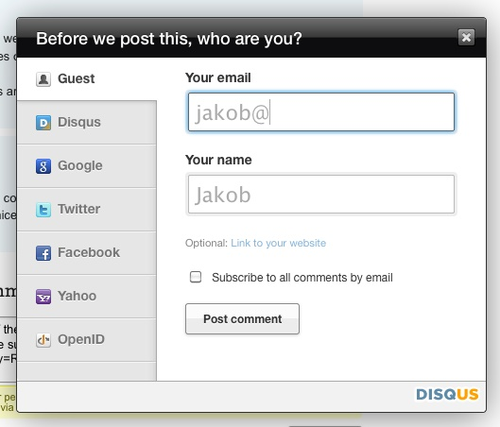
Microinteraction Examples
Guess your name based on your email address.
Microinteractions: Designing with Details
by Dan Saffer
O’Reilly Media, Inc., 2014

Slide 5
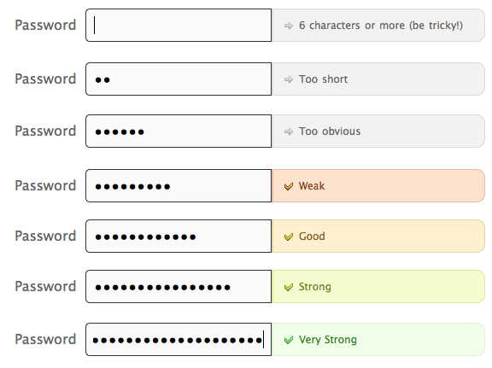
Microinteraction Examples, cont’d
Immediate feedback for password selections.
Microinteractions: Designing with Details
by Dan Saffer
O’Reilly Media, Inc., 2014

Slide 6
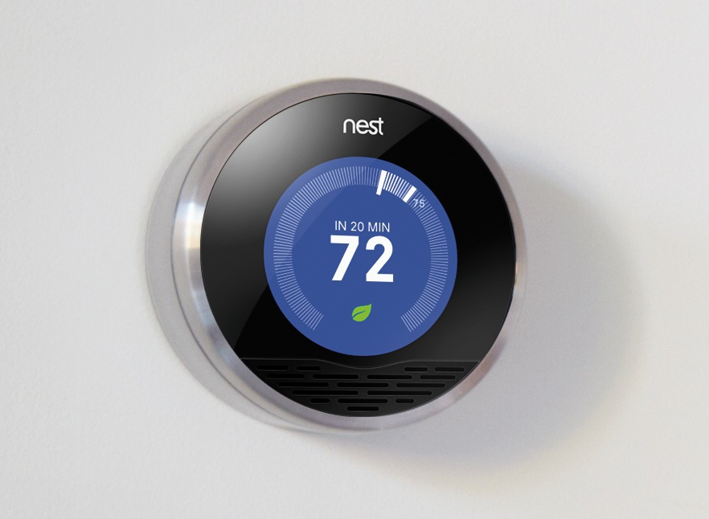
Microinteraction Examples, cont’d
The Nest Learning Thermometer lights up whenever someone walks by.
Microinteractions: Designing with Details
by Dan Saffer
O’Reilly Media, Inc., 2014

Slide 7
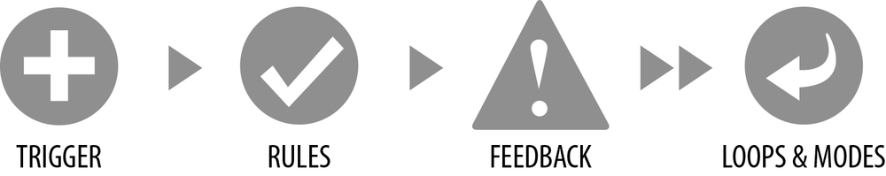
Structure of Microinteractions
The user (or the system) triggers an action.
Rules govern the system’s subsequent behavior.
The system provides feedback to the user.
Show the “personality” of the system.
Loops & modes: Does the microinteraction remain until manually turned off? Does it expire?
Microinteractions: Designing with Details
by Dan Saffer
O’Reilly Media, Inc., 2014

Slide 8
Feedback
Do not overburden users with feedback.
Use the least amount of feedback to show what is happening.
What does the user need to know, when, how often?
Feedback should occur
Immediately after a manual trigger.
Whenever the user violates a rule.
Whenever the system cannot execute a command.
To indicate progress of a long operation.
At the beginning or end of a process.

Slide 9
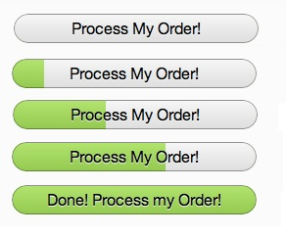
Feedback Examples
Microinteractions: Designing with Details
by Dan Saffer
O’Reilly Media, Inc., 2014

Slide 10
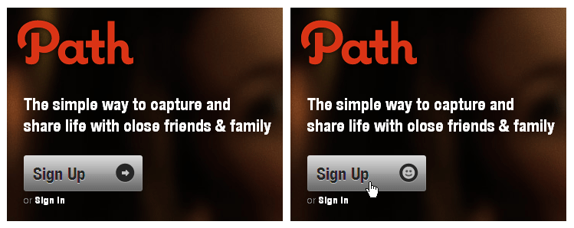
Feedback Examples, cont’d
Can you spot the feedback after the Sign Up button is clicked?
Microinteractions: Designing with Details
by Dan Saffer
O’Reilly Media, Inc., 2014

Slide 11
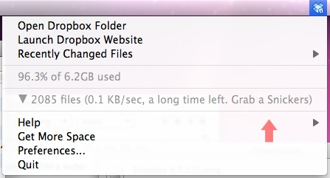
Feedback as Personality
The best feedback is never arbitrary.
Feedback is for humans.
Example of personality: Apple’s Siri

Slide 12
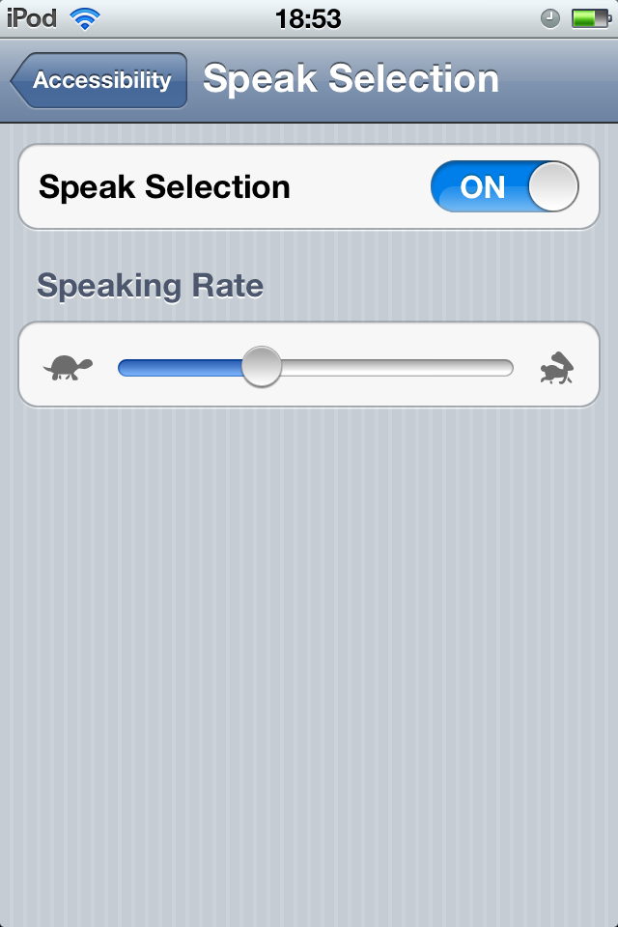
Feedback as Personality, cont’d
Feedback can be whimsical.
Microinteractions: Designing with Details
by Dan Saffer
O’Reilly Media, Inc., 2014

Slide 13
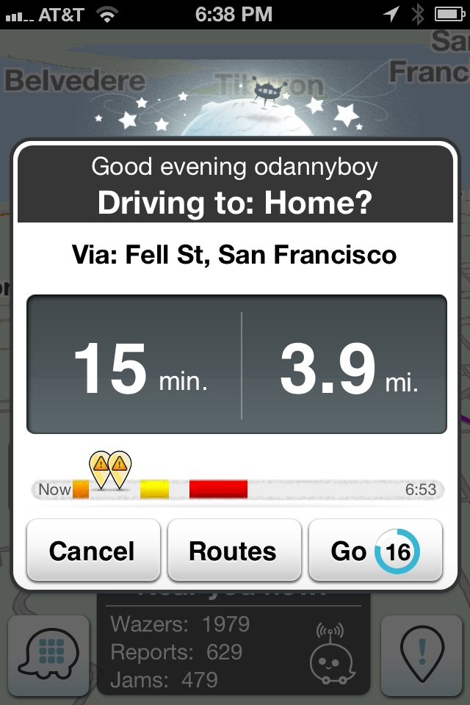
Feedback as Personality, cont’d
Feedback can be personalized.
Microinteractions: Designing with Details
by Dan Saffer
O’Reilly Media, Inc., 2014

Slide 14
Manual Triggers
Manual triggers usually spring from a user want or need.
“I need to move this object from here to there.”
“I want to purchase a book online.”
A UI designer must understand:
What a user wants or needs to do.
When they want to do it.
In what contexts will they do it.

Slide 15
Principles of Manual Triggers
Make the trigger something the users will recognize to be a trigger.
Examples: buttons, switches, icons in a menu bar
The trigger should initiate the same action every time.
Enable the user to form the correct mental model of how the microinteraction works.
Bring the data forward.
The trigger can itself reflect the data used by the microinteraction.

Slide 16
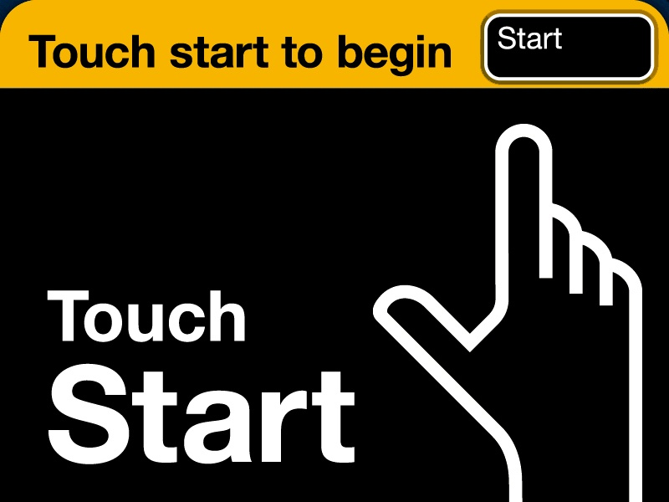
A Faux Affordance
Example of Principle #1.
The animated hand points to the Start button.
Faux affordance: Actually, the entire screen is the button.
Microinteractions: Designing with Details
by Dan Saffer
O’Reilly Media, Inc., 2014

Slide 17
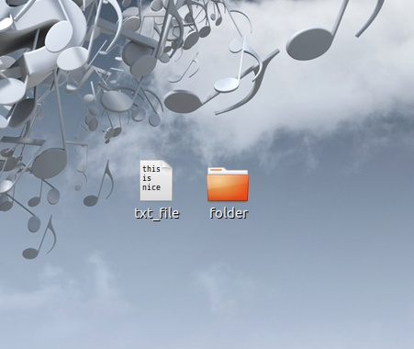
Examples of Bringing the Data Forward
Gnome desktop: The text file icon shows the first few lines of text from the file.
Microinteractions: Designing with Details
by Dan Saffer
O’Reilly Media, Inc., 2014

Slide 18
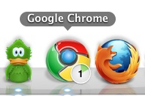
Examples of Bringing the Data Forward, cont’d
Google Chrome browser: The trigger icon indicates an active download and its progress.
Microinteractions: Designing with Details
by Dan Saffer
O’Reilly Media, Inc., 2014

Slide 19
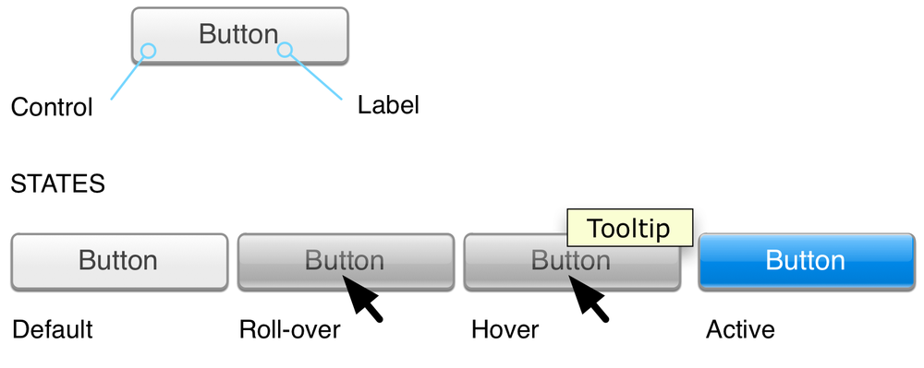
Components of a Trigger
Button: single action
Toggle: two-state action
Dial: action with several states
Slider: action along a continuum
Don’t break the visual affordance.
If it looks like a button, it should work like a button.
Microinteractions: Designing with Details
by Dan Saffer
O’Reilly Media, Inc., 2014

Slide 20
Discoverable Manual Triggers
Make manual triggers discoverable.
The more frequently a microinteraction is used, the more visible its trigger should be.
Frequency | Discoverability
Most users, most often | Highly discoverable
Some users, sometimes | Easily discoverable
Few users, infrequently | Search to find

Slide 21
Discoverable Manual Triggers, cont’d
The most discoverable triggers (from most discoverable to least):
A moving object, such as a pulsing icon
An object with an affordance and a label, such as a labeled button
An object with a label, such as a labeled icon
An object alone, such as an icon
A label only, such as a menu item
An invisible trigger

Slide 22
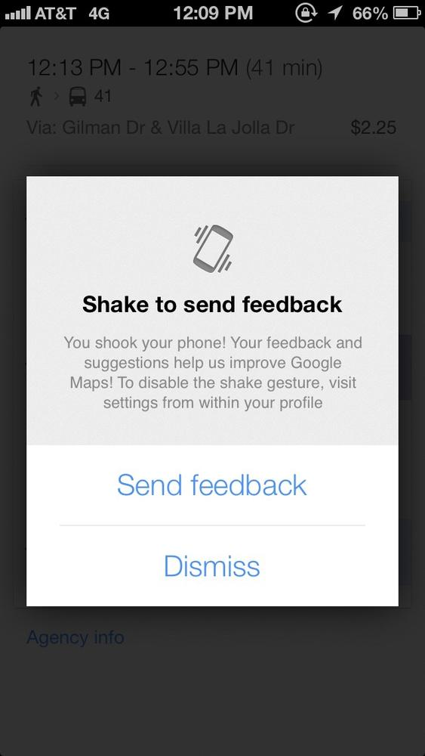
Invisible Manual Triggers
Manual triggers can be invisible:
Sensor based, such as with touchscreens, cameras, microphones, and accelerometers
Command keys
Mouse “sleep corners”
Voice input, such as Siri
Microinteractions: Designing with Details
by Dan Saffer
O’Reilly Media, Inc., 2014

Slide 23
Manual Trigger States
Default idle state: no activity
Active: background activity in progress
Hover: tool tip when the mouse hovers over
Rollover: indicate presence or activity, or that the cursor is positioned properly to engage
Click or tap: start the activity, then possibly show progress
Toggle: indicate current setting

Slide 24
“Feedforward”
Users with the correct mental model of how a microinteraction works will understand what is going to happen when they activate a trigger.

Slide 25
System Triggers
System-initiated triggers engage when certain conditions are met without user intervention:
Errors
Location
Incoming data
Internal data
Other microinteractions
Other users

Slide 26
Rules
A set of rules govern how a microinteraction behaves.
Before designing the rules, determine the goal of the microinteraction.
The more a microinteraction is focused on the goal rather than the steps, the more successful the microinteraction will be.

Slide 27
Demo: Windows 7 vs. Mac OS X
Create a text file containing the letter A.
Goal: Create a new text file containing the letter B.
Windows: Use “Save as”
Mac: Use “Duplicate” and then “Save”
Problem: The Mac requires users to know ahead of time that they want the changes to be in a different file.
Not the way most users work.

Slide 28
What the Rules Determine
How the microinteraction reacts to the trigger.
What control the user has over a microinteraction in progress.
The sequence and timing of the actions.
What data is being used and from where.
Configuration and parameters.
What feedback is delivered and when.

Slide 29
What the Rules Determine, cont’d
What mode the microinteraction is in.
Whether the microinteraction repeats and how often.
What happens when the microinteraction ends.
Users become aware of the rules
when the rules control
what the users can and cannot do.

Slide 30
Rule Constraints
What input and output methods are available?
What type and range of input is allowed?
What resource usage is expensive?
What kind of data is available?
What kind of data can be collected?

Slide 31
Rules in Context
When a trigger starts a microinteraction, make use of what is known about the user and the context to improve the interaction.
What is the platform or device?
What is the time of day?
What is the noise level of the room?
When was the microinteraction last used?
Is the user in a meeting?

Slide 32
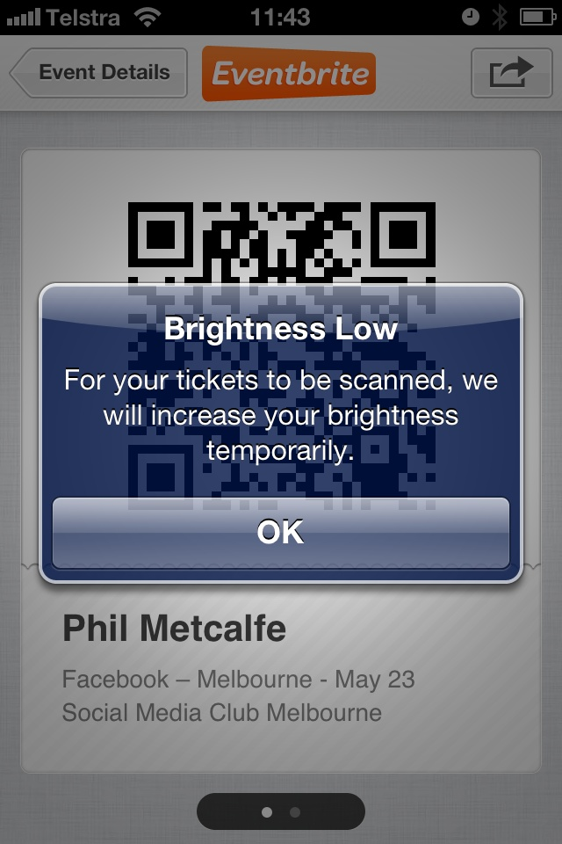
Rules in Context, cont’d
Example: The Everbrite app automatically increases the screen brightness to facilitate scanning a QR code.
Microinteractions: Designing with Details
by Dan Saffer
O’Reilly Media, Inc., 2014

Slide 33
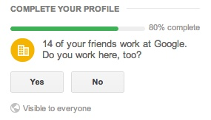
Rules in Context, cont’d
Example: Google+ guesses where you work based on where your friends work.
Microinteractions: Designing with Details
by Dan Saffer
O’Reilly Media, Inc., 2014

Slide 34
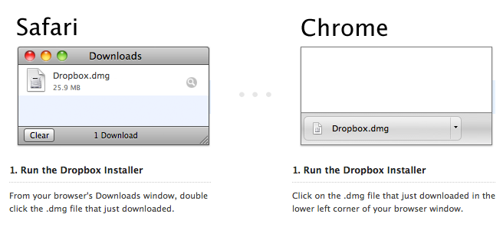
Rules in Context, cont’d
Example: Dropbox bases its download instructions on which browser you’re using.
Microinteractions: Designing with Details
by Dan Saffer
O’Reilly Media, Inc., 2014

Slide 35
The Conservation of Complexity
Tesler’s Law of the Conservation of Complexity
All activities have an inherent complexity
There is a point beyond which you cannot simplify a process any further.
You can either
Let the system handle the complexity and thereby remove control from the user.
Let the user handle the complexity by giving him or her more control.

Slide 36
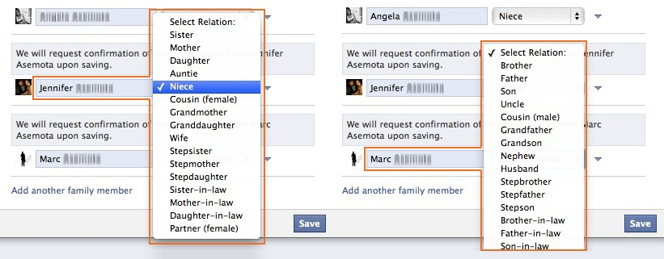
The Conservation of Complexity, cont’d
Err on the side of removing control from the user and have the microinteraction make most of the decisions.
Example: Facebook populates the relationship menu based on the family member’s gender.
Microinteractions: Designing with Details
by Dan Saffer
O’Reilly Media, Inc., 2014

Slide 37
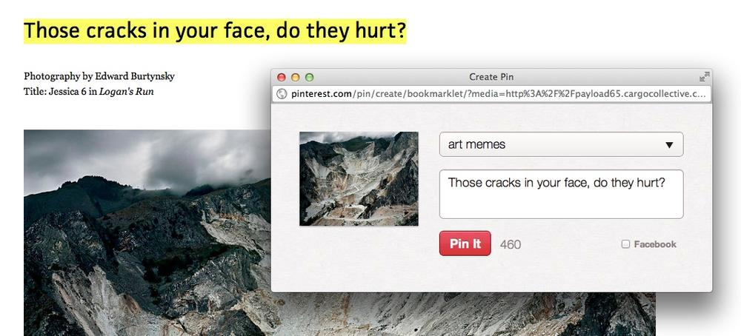
Limited Options and Smart Defaults
Limit the choices a user must make.
Provide smart defaults instead.
Example: Pinterest prepopulates the caption field with selected text.
Microinteractions: Designing with Details
by Dan Saffer
O’Reilly Media, Inc., 2014

Slide 38
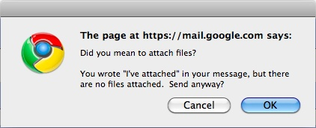
Prevent User Errors
Design microinteractions to not allow a user to make an error.
Example: Gmail
Microinteractions: Designing with Details
by Dan Saffer
O’Reilly Media, Inc., 2014

Slide 39
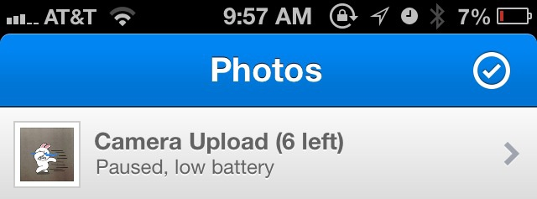
Prevent User Errors, cont’d
Example: Dropbox
Microinteractions: Designing with Details
by Dan Saffer
O’Reilly Media, Inc., 2014

Slide 40
Loops and Modes
Microinteractions: Designing with Details
by Dan Saffer
O’Reilly Media, Inc., 2014

Slide 41
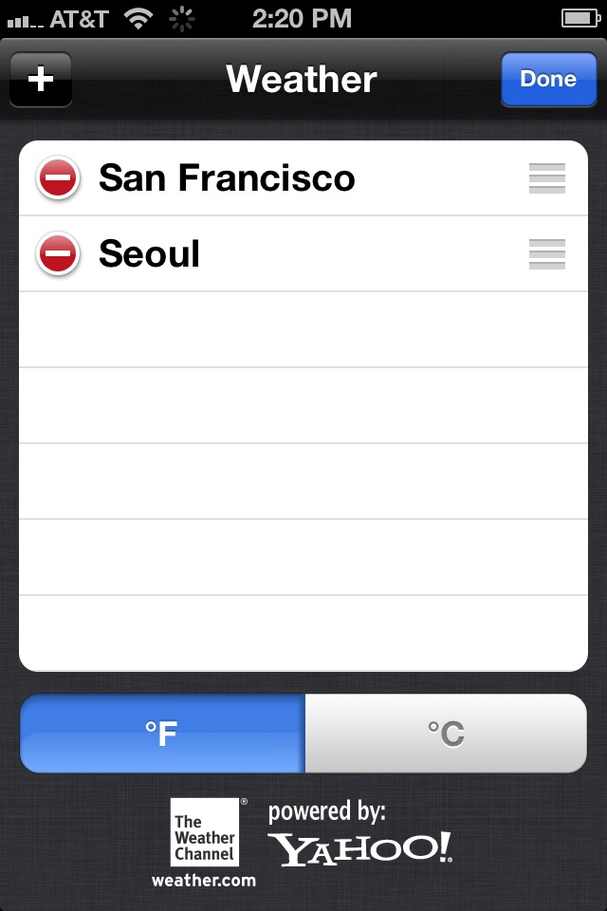
Modes
Mode = a fork in a microinteraction’s rules
Use very, very sparingly.
Good practice: A mode can use its own screen.
Example: A mode to configure a weather app.
Microinteractions: Designing with Details
by Dan Saffer
O’Reilly Media, Inc., 2014

Slide 42
Spring-Loaded Modes
A spring-loaded mode is active only during a physical occurrence such as pressing a key or holding down a mouse button.
AKA quasimodes
Advantage: The user doesn’t forget what the current mode is.
Disadvantage: Doesn’t work for long actions or actions that require complex input.

Slide 43
One-off Modes
A one-off mode is when
A user initiates a mode that lasts for the duration of a single action.
After the action, the mode turns itself off.
Example: Cut-and-paste on the iPhone.
The user double-taps on text to bring up the cut-and-paste features.
The features disappear after the user selects one command.

Slide 44
Loops
Loops are about timing.
The pace and overall lifespan of a microinteraction.
Count-controlled loop
For loop: repeat a set number of times.
Condition-controlled loop
While loop: repeat while certain conditions are true.
Collection-controlled loop
Loop over a collection of items, such as email.
Infinite loop

